Slide 1
Study Abroad Project aka. SAP
Sam
Winston
Chance
Ethan
Emily

Slide 2
Why?
Three of us have studied abroad
The UWYO Abroad website is difficult to use
Get materials for incoming and prospective students in one place.

Slide 3
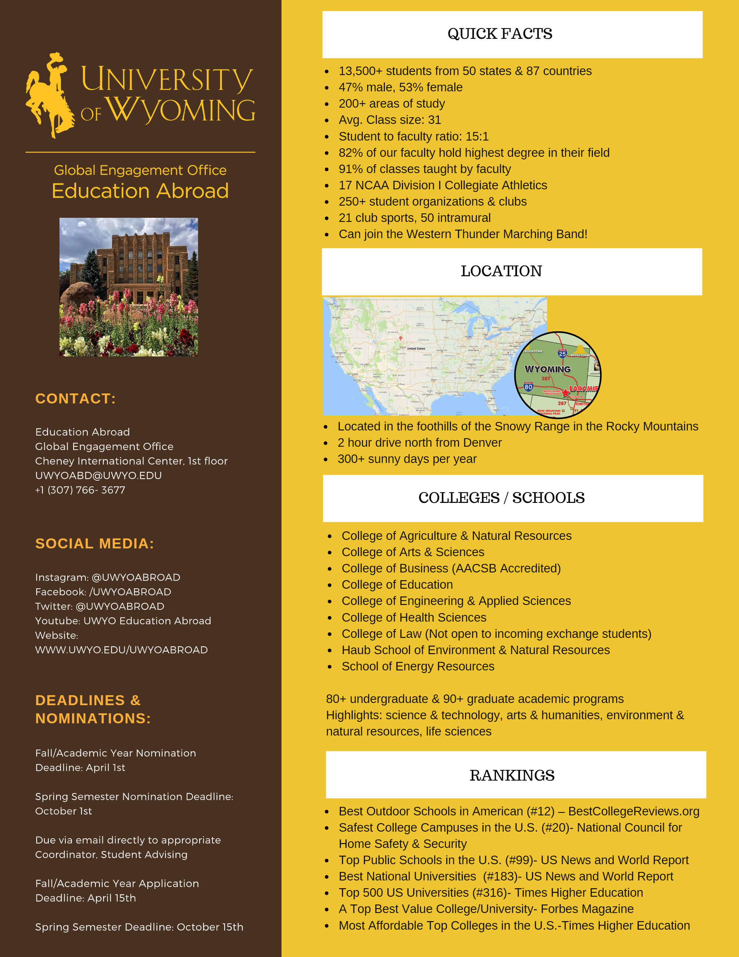
Scope of Work
- First, we'll create a navigable Android app that showcases the information provided to us from a brochure.
- Create a database of programs approved by the study abroad office to be displayed to users and allow the SAO to edit it.
- Research technologies like Google's Flutter UI Framework.
- Expand the app to provide information specific to incoming or outgoing students, send them notifications on relevant deadlines etc.

Slide 4









Tech Stack

Slide 5
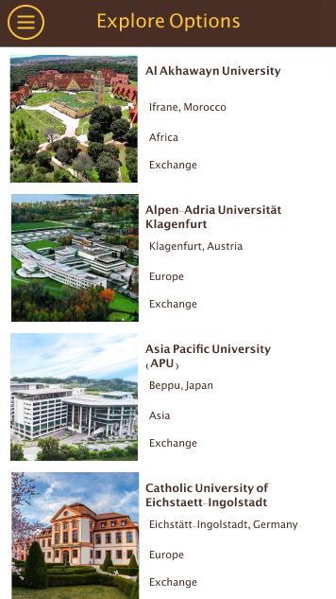
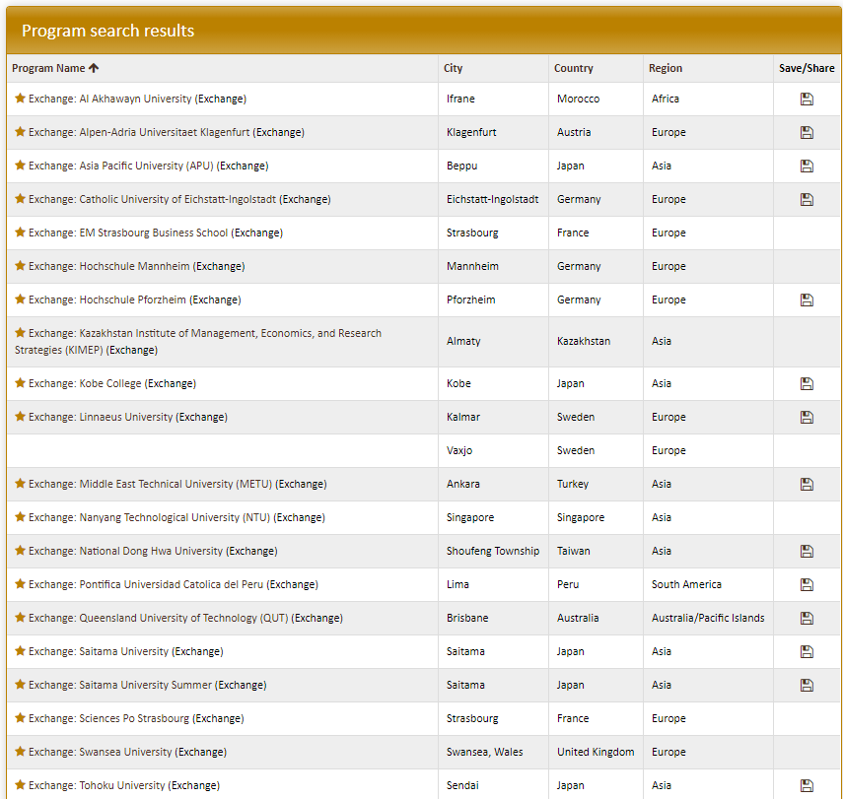
Where we are now Wireframe

